Slide 1
Model-Based Engineering Environment for Model-Based Systems Engineering
Christopher L Delp
Cin-Young Lee
Marie Piette
Jet Propulsion Laboratory, California Institute of Technology
© 2014 California Institute of Technology. Government sponsorship acknowledged.

Slide 2
Outline
Background
Architectural Drivers
Concepts for MBEE
Realization of MBEE Concepts
Architectural Trades
Technology Trades

Slide 3
MDev Team
Systems Engineering
Architecture
Testing
Training
Client We and Mobile Apps
Architecture and Design
Functional/Unit Testing
Modeling and Analysis Services
Architecture and Design
Functional/Unit Testing
Devops

Slide 4
Architecture Drivers

Slide 5
Need
Need: Provide a Platform for Modeling that Serves SysML CAE Client and Web-based View Interaction
Basic Infrastructure for Version, Workflow, Access Control
Flexibility of content
Support for Web Applications and Web-based API access

Slide 6
Approach for Assessing Adoption Barriers
Sources of Data
Practitioner Feedback
Practitioner Customer Feedback
Technique
Formal Interviews
Practitioner Community

Slide 7
Customers of Systems Engineering Products
SEs cannot radically change their existing work products
MBSE must only improve the quality of these products
MBSE must not burden consumers of SE products without providing substantial technical and/or economic value

Slide 8
Challenges for SE Practitioners using MBSE
Broad consensus behind MBSE
Less consensus on what it is or how to do it
MBSE Challenges for SEs
not used to working in collaborative integrated environment
not used to formal version control of SE artifacts
Not used to explicitly cross-referencing items representing modeled elements of the system.
Challenges for SE practitioners describing systems
Not used to using languages or formal vocabulary for describing systems
Not used to having explicit representations of systems beyond requirements and design review packages
Challenges for SE practitioners analyzing systems
Not used to formal analysis at level of system
Several areas of analysis are not yet clearly defined for SEs
Challenges for SE practitioners communicating about systems
Complex options for visualization
Difficulty with flexible yet accurate visualizations

Slide 9
Challenges with state of the practice MBSE
Practices
Language standards not flexible enough to accommodate range of visualization
Apps and Tools
Tools do not provide efficient communication mechanisms
Tools lack fast simple collaboration capabilities
Lack of interoperability still an enormous challenge
Lack of web-based access still a challenge
Focus on a narrow slice of the lifecycle.

Slide 10
Challenges for Scaling MBSE in the Enterprise
Collaboration
Large engineering teams working across the models and products
Managing Large Complex Models
order of millions of elements
Complex reuse
Variations and trades
Configuration Management
Managing propagation of changes
Managing system configuration
Guaranteeing Completeness And Consistency
Rules-based checking and correcting of models and data
Flexibility
The world will never be entirely model based
Elements considered outside the scope of models will always be a part of the business models live in
Authority and Providence Management
Who can do what with what

Slide 11
Architecture Concepts
Informaton

Slide 12
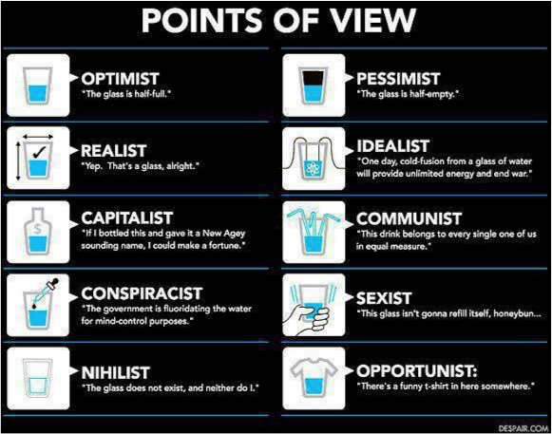
Engineer
“The glass is twice as big as it needs to be”

Slide 13
Information Concepts
Information Fundamentals
Classes
Properties
Expressions

Slide 14
Information Concepts
Specific use model
Mission Specific
Project Specific
Misison-Specific Adaptation
DSLs
Libraries
SysML
Launch Vehicles, etc
Hardware, Units etc
Model Management and Analysis
Kernel
Kernel
Properties
Expressions
Executable
Content Objects
Content Objects
Uniquely ID Objects
Documents & Files
Relatable

Slide 15
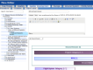


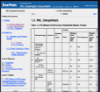
Functional Concept: Describe Analyze Communicate
Describe Model of System using Views
Analyze Models
Collaborative Work
Model Management Service (MMS)
Collaborative Consumption and Review
Produce Expected Documents and Products
Communicate changes to collaborators
Notes:
Corresponds to info exchange, model manager and info exchange manager

Slide 16
Describe Analyze Communicate
Describe Model of System using Views
Analyze Models
Collaborative Work
Model Management Service (MMS)
Collaborative Consumption and Review
Produce Expected Documents and Products
Communicate changes to collaborators
Notes:
Corresponds to info exchange, model manager and info exchange manager

Slide 17
Model-Based Engineering Environment
Model Manager
Project Ops
(Workflow and Metrics)
Phoenix
APGen
Model Management Service
Analysis Workbench
EMS App Architecture
Modelica
Rules Engine
View Editor
Enterprise Integration Framework
SLIM
Docweb
…
Data Manager
HTTP REST
MDK (MD)

Slide 18
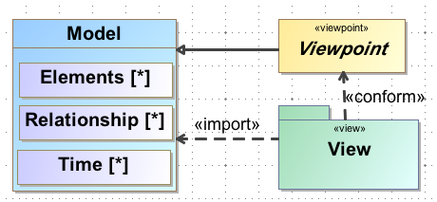
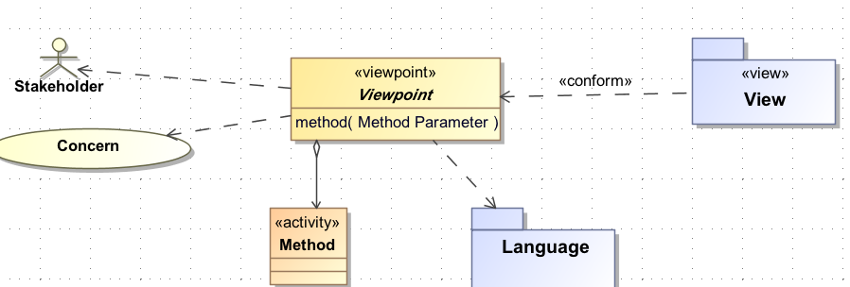
Building the Viewpoint Model
Viewpoint Model
Purpose informed by Stakeholder Concerns
Methods and Analysis for constructing the View from the Model
Presentation Rules

Slide 19
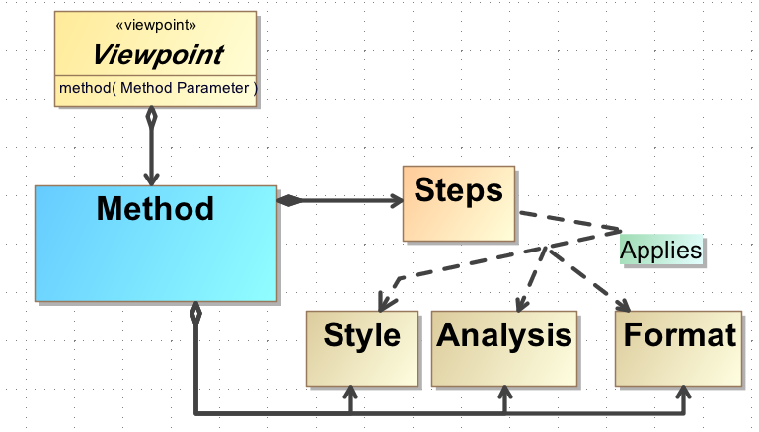
Method and Analysis
Methods
Ordered steps for producing the View
Analysis
describe the nature of queries of the model
Analytical assertions
Rules for completeness and consistency
Format and Presentation Style
Describe the conventions, styles and formats for how the information is presented in the View

Slide 20
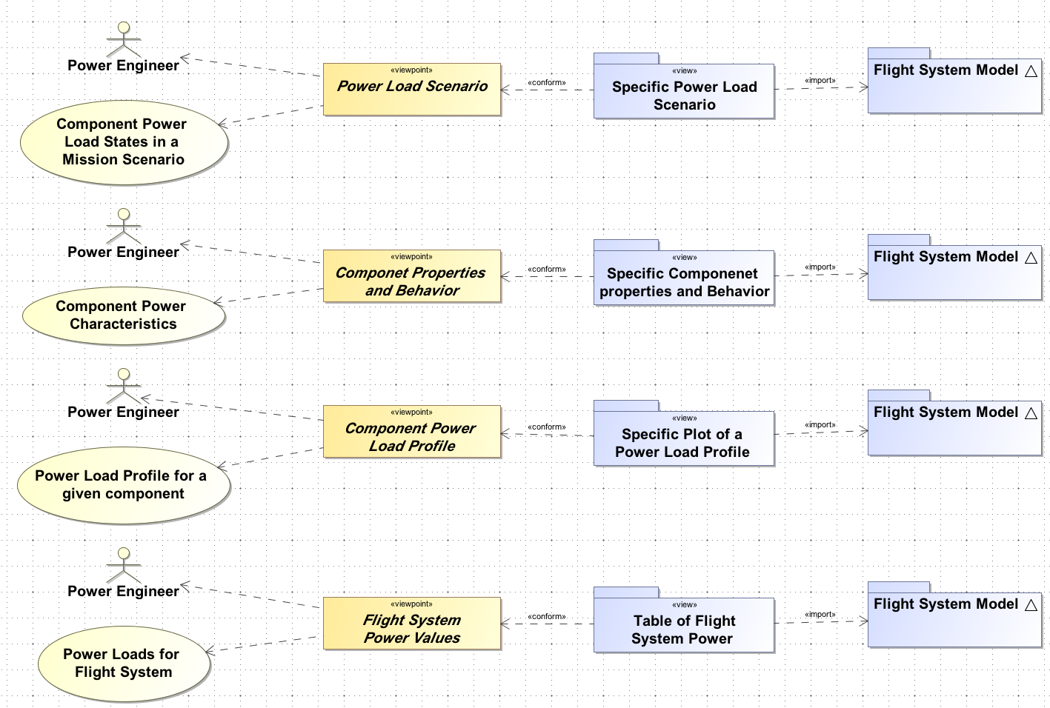
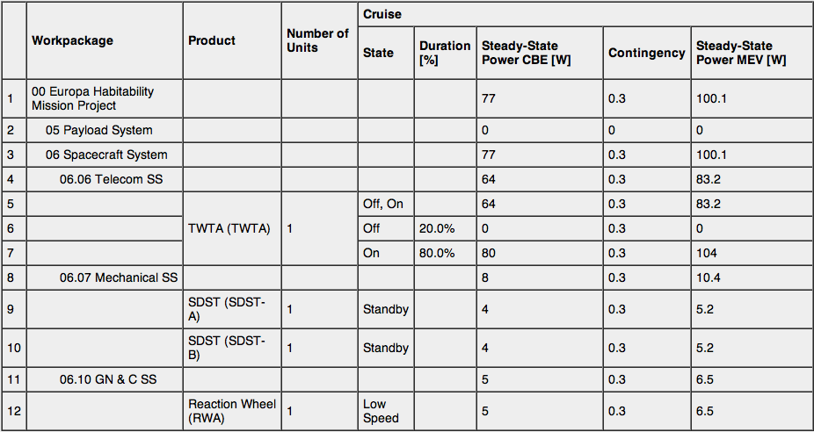
Views of Models

Slide 21
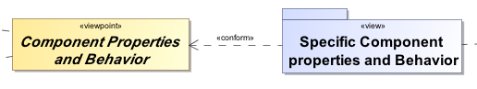
Simple Spacecraft Diagram Views
Spacecraft Star tracker Behavior
Spacecraft SysML IBD
Star Tracker Behavior Scenario

Slide 22
Operations Processes and Checklists
Training Document
Training View Models
Layered Story through process
Understand bigger picture down to smallest detail
Checklist Views
Single thread through entire process
Layout the clean step-by-step
Minimum amount of information to do the job
Operational Checklist
Step 1
Step 2
Sub Step 1
Sub Step 2

Slide 23
MBEE Realization

Slide 24
Description Realization
Project-Specific Adaptations
Mission Specific
Project Specific
Project Specific Adaptation
Domain Specific Languages
Flight systems
Various DSLs
Model Management Service (MMS)
SysML
SysML
No UML
Onto-Behavior
Rules as Expressions
K
“K”ernel language
Objects, Properties, Relationships
Content Objects
Content Objects
Uniquely ID Objects
Documents
Files

Slide 25
Software Development Pipeline
Task
IDE
(Eclipse)
CM Server
(GitHub)
CI Server
(Jenkins)
Host
(Test, Stg, Prod)
Develop
Manage
Build/Test
Deploy
Share
Artifact Repository
(Nexus)
IDE
(Eclipse)
CM Server
(GitHub)
CI Server
(Jenkins)
Host
(Test, Stg, Prod)
Task
Develop
Manage
Build/Test
Deploy

Slide 26
Model Development Pipeline
Task
Modeling Tool
(MDK, EVM)
CM Server
(MMS)
CI Server
(PMA)
Host
(Documents)
Develop
Manage
Build/Analyze
Communicate
Share
Middleware
(DEA)
Task
Modeling Tool
(MDK, EVM)
CM Server
(MMS)
CI Server
(PMA)
Host
(Documents)
Develop
Manage
Build/Analyze
Communicate
Notes:
Git stores flat files with no metadata. Relationships are inferred and can’t be queried out as they aren’t explicit.

Slide 27
MBEE System Realization
Angular Apps
Phoenix
Model Management Service
Angular Plugin Framework
Mobile Apps
Models and Rules
APGen
Alfresco
Modelica
Oracle Data Exchange Architecture
Customized Alfresco Share
Artifacts and Products
SLIM
MDK (MD)
HTTP REST
Oracle Apps

Slide 28
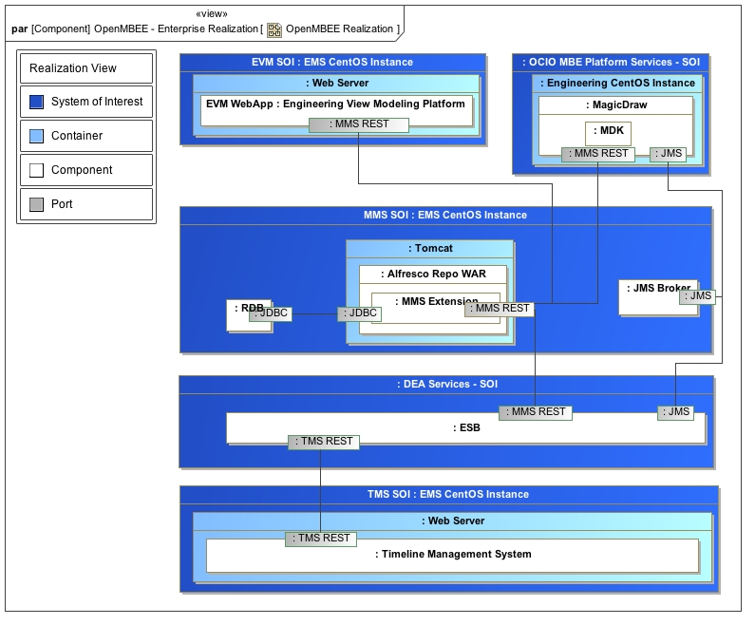
Current Realization

Slide 29
Technology Alternatives

Slide 30
Technology Assessment Approach
Establish Criteria from drivers
Assess candidate technologies against concepts
Build prototypes
Assess ability to build software that meets modeling requirements
Deploy to practitioners
Assess adoption through feature requests and feedback

Slide 31
Technology
Web Apps
Mobile Apps
Client and Services Integrations
Angular JS Framework
Mobile Framework
HTTPS REST
Oracle Enterprise Integration Framework
Alfresco and Stanbol with MBSE Services
Hybrid Virtual Private Cloud
Technology Decisions
Modeling Services
Apps
Enterprise Integration
Modeling Standards
Make vs Buy
Rules Engine
MBSE Web and Mobile Apps
Modeling Language Extensions

Slide 32
Technology Criteria for Modeling Services
Flexible Modeling Support
Compatible with Object-Oriented Models for metadata
Facilitate other structures
Enterprise Infrastructure Support
Access control, notifications, versioning, workflow
API and web services that are extensible
Enterprise Collaboration
Support for multiple concurrent users of the system
Standards
Support for standards is preferred
Scalable
Built to handle collaboration and throughput commensurate with use by a flight project lifecycle

Slide 33
Technology Options for Model Services
Alternatives for Building Resources and Services around OO models
Databases
Relational
NoSQL (RDF, Graph etc)
Enterprise Application Frameworks
Enterprise Platforms
Enterprise Content Management Systems
Enterprise Wikis

Slide 34
Technology Assessed
Databases
Sesame, Jena, Neo4J
Enterprise Application Frameworks
Vadin, Django, Rails, Jboss, Spring
Enterprise Platforms
Enterprise Content Management Systems
Alfresco, Nuxeo, Sharepoint, Magnolia
Enterprise Wikis
Xwiki, semantic media wiki

Slide 35
Uncertainty
Role of NoSQL in enterprise
Many NoSQL solutions are growing and changing quickly.
All seem to focus on specialized applications with no clear future for providing richer enterprise support.
Graph databases seem to have matured and started pulling in versioning, granular access control, etc.
Linked Data concepts seem to be factoring into web technologies
Things such as JSON LD, micro formats, OSLC and data etc seem to be incorporating semantic web into more common technologies.
Notes:
Open services for lifecycle collaboration

Slide 36
Analysis Results

Slide 37
Evaluating Alternative Model Services Technology
 | Flexible | Enterprise Infrastructure | Enterprise Collaboration | Standards | Scale
NoSQL | X | -- | -- | ~ | ~
E Wiki | -- | ~ | X | -- | ~
WebAF | X | X | X | ~ | ~
E CMS | X | X | X | X | X
Overall Web Application Frameworks and Enterprise Content Management Systems provided the most comprehensive support for a Model Management System
WAF generally required more development work to build a working system
Enterprise Content Management Systems in general had the same options as WAF but they also functioned as a platform. In other words they had out-of-the-box capability that can be harnessed without application development.
X Completely meets criteria
~ Non-trivial effort to meet criteria
-- Fails Criteria

Slide 38
Semantic Web Architectural Prototype
View Editor
Sesame triple-store
JQuery/Javascript Web App
MD Client plugin
Conclusions
Lack of infrastructure for RDF is a major issue for projects
No versioning, granular access control, workflow
SysML <-> triples is feasible

Slide 39
Semantic Web Alternatives
 | Flexible | Infrastructure | Collaboration | Standards | Scale
Sesame | X | - | - | X (RDF OWL) | ~
Jena | X | - | - | X (RDF OWL) | ~
NEO4J | X | - | - | - | ~
Stanbol | X | ~ | X | X (RDF OWL CMIS) | ~
Overall Web Application Frameworks and Enterprise Content Management Systems provided the most comprehensive support for a Model Management System
WAF generally required more development work to build a working system
Enterprise Content Management Systems in general had the same options as WAF but they also functioned as a platform. In other words they had out-of-the-box capability that can be harnessed without application development.
X Completely meets criteria
~ Non-trivial effort to meet criteria
-- Fails Criteria

Slide 40
Web App Framework Prototypes
Architecture Framework Tool and Docweb
Django
Python Web Application Framework
Conclusions
Rich capabilities
Requires full burden of implementation
No versioning, granular access control, workflow, two way relationship traversal, quick search
No support for NoSQL repositories

Slide 41
Evaluating Alternatives
 | Flexible | Infrastructure | Collaboration | Standards | Scale
X-Wiki | -- | X | X | -- | X
Media Wiki | -- | ~ | X | -- | X
Semantic Media Wiki | ~ | ~ | X | -- | X
Overall Web Application Frameworks and Enterprise Content Management Systems provided the most comprehensive support for a Model Management System
WAF generally required more development work to build a working system
Enterprise Content Management Systems in general had the same options as WAF but they also functioned as a platform. In other words they had out-of-the-box capability that can be harnessed without application development.
X Completely meets criteria
~ Non-trivial effort to meet criteria
-- Fails Criteria

Slide 42
Evaluating Alternatives
 | OO | Infrastructure | Collaboration | Standards | Scale
Alfresco | X | X | X | X | X
Sharepoint | -- | X | ~ | ~ | X
Nuxio |  | X |  | X | X
Magnolia |  | X |  | X | X
Joomla | -- | ~ | X | X | ~
Overall Web Application Frameworks and Enterprise Content Management Systems provided the most comprehensive support for a Model Management System
WAF generally required more development work to build a working system
Enterprise Content Management Systems in general had the same options as WAF but they also functioned as a platform. In other words they had out-of-the-box capability that can be harnessed without application development.
X Completely meets criteria
~ Non-trivial effort to meet criteria
-- Fails Criteria

Slide 43
Conclusions
MMS Technology Choice – Alfresco with Stanbol Augmentation
NoSQL solutions offer powerful options but require substantial investment
Wikis offer strong collaboration but lack underlying infrastructure
Web Application Frameworks are too costly build and maintain

Slide 44

Deployment Architecture
Automated Test & Deployment
Cloud Server
Cloud Server
Alfresco Repository
Alfresco Repository
Jenkins
Grunt
Maven
Salt
Legend
Timeline Repository
Timeline Repository
Eclipse Dev Env
Oracle Dev Env
OCIO Platform Components
Software Builds,
Unit and Regression Tests
Eclipse Dev Env
Oracle Dev Env
Cloud Server
Alfresco Repository
STK
Timeline Repository
STK
Eclipse Dev Env
Oracle Dev Env
MagicDraw
MDK
STK
MagicDraw
MDK
Modelica
MagicDraw
MDK
Europa Developed
PhoenixMC
SLIM
Modelica
Windows Engineering Image
Modelica
Linux Engineering Image
SLIM
PhoenixMC
SLIM
Scalr
PhoenixMC
Windows Engineering Image
Windows Engineering Image
Github
Linux Engineering Image
Linux Engineering Image
Cloud Server
Cloud Server
Cloud Server
Cloud Server
Cloud Server
Alfresco Repository
Alfresco Repository
Alfresco Repository
Alfresco Repository
Alfresco Repository
Timeline Repository
Timeline Repository
Timeline Repository
Timeline Repository
Timeline Repository
Eclipse Dev Env
Oracle Dev Env
Eclipse Dev Env
Oracle Dev Env
Eclipse Dev Env
Oracle Dev Env
Eclipse Dev Env
Oracle Dev Env
Eclipse Dev Env
Oracle Dev Env
STK
MagicDraw
MDK
STK
MagicDraw
MDK
STK
MagicDraw
MDK
STK
MagicDraw
MDK
STK
MagicDraw
MDK
Modelica
Modelica
Modelica
Modelica
SLIM
Modelica
PhoenixMC
SLIM
PhoenixMC
SLIM
PhoenixMC
SLIM
PhoenixMC
PhoenixMC
SLIM
Windows Engineering Image
Windows Engineering Image
Windows Engineering Image
Windows Engineering Image
Windows Engineering Image
Linux Engineering Image
Linux Engineering Image
Linux Engineering Image
Linux Engineering Image
Linux Engineering Image
DEA
Orchestrated Processes

